Slide 1
B.A. (PROG)
NAAC REPORT
2015-18

Slide 2
Introduction
The B.A.(Pass) Course, now B.A(Prog) and English Hons
were the only courses offered by the college in 1968 having 116 students. Today it is the biggest department of the college having around 900 students enrolled in 15 discipline combinations.

Slide 3
Faculty details of the B.A. (prog.) Department which do not have honours
PHILOSOPHY | Dr. Gargi Jain | Associate Professor
 | Dr. Preeti Ranjan Gosh | Associate Professor
 | Sulagna Pal | Assistant Professor (Ad Hoc)
SPANISH | Dr. Dinesh Adlakha | Associate Professor
 | Dr. Dhiraj K. Rai | Guest Lecturer
FRENCH | Ms. Sukham P. Chawla | Assistant Professor (Ad Hoc)
 | Mr. Arvind Kumar | Guest Lecturer
COMPUTER | Dr. Pavitra Bhardwaj | Assistant Professor
 | Dr. Shweta Paradkar | Assistant Professor (Ad Hoc)

Slide 4
Faculty Contributions
Dr. Pavitra Bhardwaj
· Delivered a lecture at Refresher Course HRDC, University of Rajasthan on “Human Resource Development in IT Industry : A Leverage to sustainable Development of India”
Delivered around Fifty e-lectures at the Consortium for Education through Communication (CEC), UGC, Delhi on various topics related to Management and Computer Science
Delivered a lecture on "Human Resource Development in the Indian IT Industry : A leverage to Sustainable Development of SAARC Region" at the SAARC Workshop organised by SHRDC, Pakistan and MHRD, Govt of India, Delhi, April 2015.
Delivered a lecture on "ICT for enhancing the accessibility and quality of Education in India a roadmap for SAARC Countries" at the SAARC Workshop organised by SHRDC, Pakistan and MH RD, Govt of India, Delhi, August 2015.

Slide 5
Faculty details of the B.A. (Prog.) Departments which do not have honours
PHILOSOPHY | Dr. Gargi Jain | Retired Associate Professor ( Retired in Jan.’19)
 | Dr. Preeti Ranjan Gosh | Associate Professor
 | Sulagna Pal | Assistant Professor (Ad Hoc)
SPANISH | Dr. Dinesh Adlakha | Associate Professor
 | Dr. Dhiraj P. Rai | Guest Lecturer
FRENCH | Ms. Sukham P. Chawla | Assistant Professor (Ad Hoc)
 | Mr. Arvind Kumar | Guest Lecturer
COMPUTER | Dr. Pavitra Bhardwaj | Assistant Professor
 | Dr. Shweta Paradkar | Assistant Professor (Ad Hoc)

Slide 6
Awards/ Achievements/Recognitions received by teachers
Ms. Sukham P. Chawla | Received the scholarship from ministry of education of France for the research work in didactics of French in Sorbonne Nouvelle, Paris ( Oct.-Nov. 2015).

Slide 7
Eminent academicians and resource persons invited
Dr. Ena Panda
(French)
Dr. Sudha Jha
(History)
Jean-Yves Gillon
(French)
Dr. Charu Sawhney (Sociology)
Dr. Shifa Haq (Psychology)

Slide 8
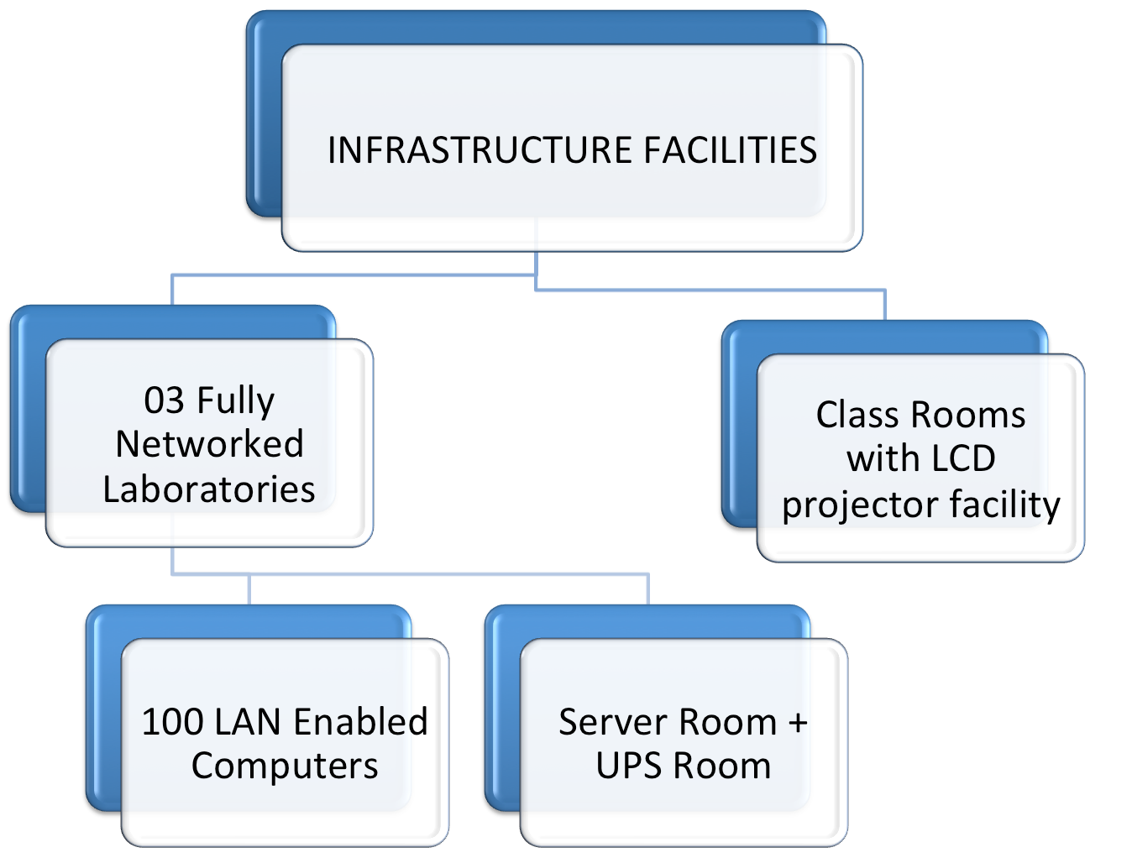
TEACHING METHODOLOGY
Innovative teaching methodologies and modern technology are used in the language classroom which are well equipped with educational tools
Audio-visual aids are used at regular intervals to develop the communicative skills of the students. And the documents of all the genres are included in the teaching of french to bring in the diversity of documents in the classroom.

Slide 9
LAPTOP
INTERACTIVE TEACHING SITES : MENTIMETER, PADLET…
INTERNET FACILITY
EDUCATIONAL TOOLS
LED PROJECTOR
WHITE BOARDS

Slide 10
Learning Outcome
Students of B.A(P) CA III year had created gaming software using Python as the programming language.
Students of B.A(P)CA II year made websites using HTML and JavaScript and Animation movies using tools such as Animator and Flash.
Students of Computer application make use of Open Source software such as GIMP for image editing.

Slide 11
Publications by the Faculty
Ms. Sukham P. Chawla | French Grammar for beginners ( Bilingual version), 2017.
 | Article «DE LA COMPETENCE VISUELLE VERS LA COMPETENCE CULTURELLE A TRAVERS LES BD » published in Reflexions, journal of University of Hyderabad, 2015.

Slide 12
Alumni Report
- Facebook page dedicated to the B.A. Prog students of JMC
- Alumni invited for lectures:
Prachi Gangwani - Yoga and Mental Health
Neeti Paul - Vice President Star sports spoke on alternative job opportunities
Dr. Sanchi Rai - On “ No Stopping after B.A.”

Slide 13
Departmental meetings
- Departmental meetings are held twice a month to discuss various departmental needs.
Events
1. Mélange, department fest, held every year.
2. Fresher’s and farewell organised every year for the students.
3. Teacher’s day celebration.
4. French library visit
5. Campus france invited to give a talk on scope of french in india and the details of the scholarships.
6. French film screening and quiz
7. Interclass competitions on french cuisine,singing,poetry recitation , comic strip makingand poetry composition.-
8. Fund raiser activities organised.

Slide 14
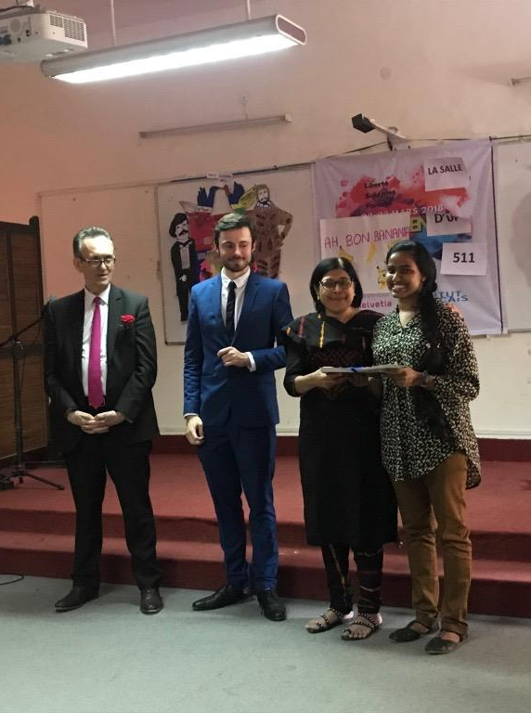
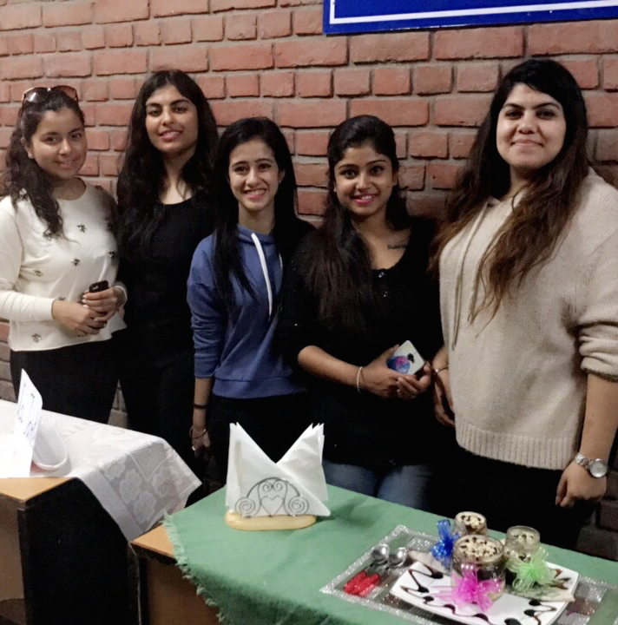
Participation of students in extra curricular activities
JMC participates every year ( 2013 onwards) in Arts Faculty’s “ Francophonie Day” and win prizes in various categories.
Participation in intercollege and intracollege activities

Slide 15
OUR PRIDE !!
Jessica Anna James of Computer Applications was selected for parasailing through NCC and represented JMC during PM rally at Delhi Cantt.(2018), after going through three levels of screening.

Slide 16
Alina Tomy of Computer Applications bagged the First position in the Solo Dance during NCC National Integration Camp held at Varanasi , representing NCC Delhi Directorate in 2017.

Slide 17
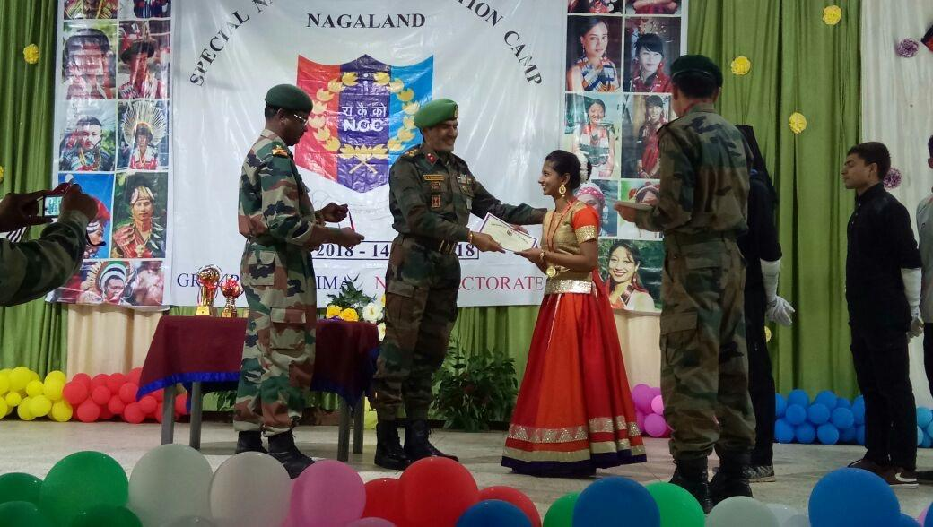
Jenyce Matthews of Computer Applications year bagged First position in group dance during Special National Integration Camp held in Dimapur, Nagaland in 2018

Slide 18
Student Diversity
Foreign students
Outstation students
North-East students
Students from non-Hindi speaking zones
Different school backgrounds (Convent/Public/ Government)
Different Socio-economic status
Persons with disability

Slide 19
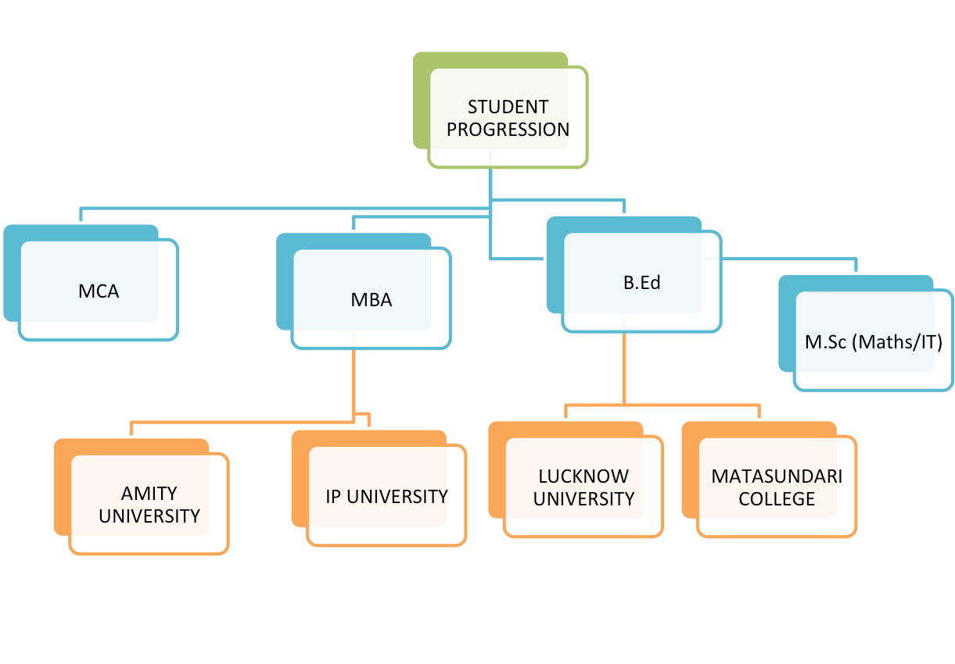
Student Progression

Slide 20
Interpretor
Working in
travel
agencies
Language
teacher
in schools
Higher
education
in language
Language experts in BPOs/KPOs

Slide 21
Outreach activities taken up by the department
Department conducts various computer training sessions for the students of NCWEB throughout the year during the vacations of the regular students.
French classes given to the students of Honours courses in 2015-16.

Slide 22
Mentor Ward System
- Each teacher of the department mentors a group of 20-25 students

Slide 23
SWOC
STRENGTHS
State of the art infrastructure in computer lab.
Willing and enthusiastic students.
Library and rich online content is available on all topics related to the subject
Student teacher relationship
Well-equipped Labs with state of the art Hardware.
Internet and Wi-fi-connectivity
Qualified and trained faculty members.
Extensive use of LCD projectors
Open Source Software
Qualified faculty
Parent teacher meeting held to keep the parents updated about the performance of their ward.
WEAKNESS
Do not have a full honors program, which causes students from having to change their stream after graduation.
Limited contact with companies and people working in the real business world like web designers, animators etc.
The prescribed curriculum has no provision of industrial training and exposure which is imperative for a field like computer science.

Slide 24
OPPORTUNITIES
The field of computer Science is one of the most promising one in today’s world.
The students find a variety of career options after graduation ranging from higher studies to joining Multi national companies, hotels , banks and government sector owing to their comprehensive training in computer science discipline.
Students can also begin their own web designing, multimedia and advertising agency after graduation.
Internships/trainings done by the students.
Communication skill enhancement and organizational capability
CHALLENGE
We are striving towards working up on industry contact and collaboration program.
We also look up towards organizing more intradepartmental events like seminars. Talks and workshops etc.
Infrastructure Improvements
Industry Patnerships
Rigorous Placements

Slide 25
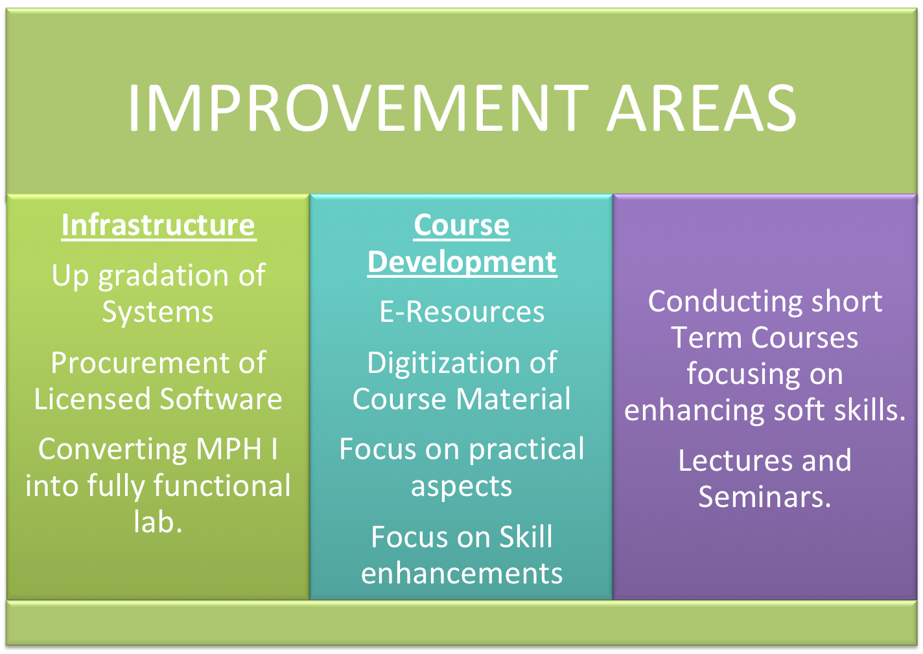
- e-waste disposal drive to be started in college.
-Working to collaborate with an NGO for paper recycling.
- Hold workshops on philosophical counselling.
- Planning to have honors/ post graduation in Philosophy, French, Spanish and Computers.
- Setting up a fully equipped language laboratory.
- Course of basic French language skills for underprivileged children.
- Alumni of BA Prog to be strengthened
- Career Development Facilitation
- More Self-development workshops for students
- Internships / Projects for students
- Alumni meet to be held every year
FUTURE PLANS

Slide 26
Awards/ Achievements/Recognitions received by teachers
Ms. Sukham P. Chawla | Received the scholarship from ministry of education of France for the research work in didactics of French in Sorbonne Nouvelle, Paris ( Oct.-Nov. 2015).

Slide 27
Seminars/Conferences/Workshops organised
Date | Title | Source of Fundings

Slide 28
Eminent academicians and resource persons invited
Dr. Ena Panda
(French)
Dr. Charu Sawhney (Sociology)
Dr. Shifa Haq (Psychology)
Dr. Sudha Jha
(History)
Jean-Yves Gillon
(French)

Slide 29
TEACHING METHODOLOGY
INNOVATIVE TEACHING METHODOLOGIES AND MODERN TECHNOLOGY ARE USED IN THE LANGUAGE CLASSROOM WHICH ARE WELL EQUIPPED WITH EDUCATIONAL TOOLS
AUDIO-VISUAL AIDS ARE USED AT REGULAR INTERVALS TO DEVELOP THE COMMUNICATIVE SKILLS OF THE STUDENTS. AND THE DOCUMENTS OF ALL THE GENRES ARE INCLUDED IN THE TEACHING OF FRENCH TO BRING IN THE DIVERSITY OF DOCUMENTS IN THE CLASSROOM.

Slide 30
Learning Outcome
Students of B.A(P) CA III year had created gaming software using Python as the programming language.
Students of B.A(P)CA II year made websites using HTML and JavaScript and Animation movies using tools such as Animator and Flash.
Students of Computer application make use of Open Source software such as GIMP for image editing.

Slide 31
Laptop
Interactive teaching sites : Mentimeter, padlet…
INTERNET FACILITY
EDUCATIONAL TOOLS
DATA PROJECTOR
WHITE BOARDS

Slide 32
Publications by the Faculty
Ms. Sukham P. Chawla | French Grammar for beginners ( Bilingual version), 2017.
 | Article «DE LA COMPETENCE VISUELLE VERS LA COMPETENCE CULTURELLE A TRAVERS LES BD » published in Reflexions, journal of University of Hyderabad, 2015.
Dr. Roshan P. Xalxo | (2014) "Kripkean Theory of Reference: A Cognitive Way" Jadavpur Journal of Philosophy, Jadavpur. ISSN: 0975-6833
 | (2012) " Necessity: A cornerstone of Modern Metaphysics" Indian Journal of analytic Philosophy, Utkal university. ISSN :0976-2337

Slide 33
Major/minor research projects undertaken by the members

Slide 34
Alumni Report
- Facebook page dedicated to the B.A. Prog students of JMC
- Alumni invited for lectures:
Prachi Gangwani - Yoga and Mental Health
Neeti Paul - Vice President Star sports spoke on alternative job opportunities
Dr. Sanchi Rai - On “ No Stopping after B.A.”

Slide 35
Departmental meetings
- Departmental meetings are held twice a month to discuss various departmental needs.
Events
1. MÉLANGE, DEPARTMENT FEST, HELD EVERY YEAR.
2. FRESHERS AND FAREWELL ORGANISED EVERY YEAR FOR THE STUDENTS.
3. TEACHER’S DAY CELEBRATION.
4. WORKSHOP ON ANIMATION
5. ORGANISED “FÊTE DE LA FRANCOPHONIE” DURING MÉLANGE
6. FRENCH LIBRARY VISIT
7. CAMPUS FRANCE INVITED TO GIVE A TALK ON SCOPE OF FRENCH IN INDIA AND THE DETAILS OF THE SCHOLARSHIPS.
8. FRENCH FILM SCREENING AND QUIZ
9. INTERCLASS COMPETITIONS ON FRENCH CUISINE,SINGING,POETRY RECITATION AND POETRY COMPOSITION.-
10. FUND RAISER ACTIVITIES ORGANISED.
11. AN EXCURSION TO GURGAON FOR “ CIRQUE DU SOLEIL”

Slide 36
Participation of students in extra curricular activities
JMC participates every year ( 2013 onwards) in Arts Faculty’s “ Francophonie Day” and win prizes in various categories.
Participation in intercollege and intracollege activities

Slide 37
OUR PRIDE !!
Jessica Anna James of Computer Applications was selected for parasailing through NCC and represented JMC during PM rally at Delhi Cantt.(2018), after going through three levels of screening.

Slide 38
Alina Tomy of Computer Applications bagged the First position in the Solo Dance during NCC National Integration Camp held at Varanasi , representing NCC Delhi Directorate in 2017.

Slide 39
Jenyce Matthews of Computer Applications year bagged First position in group dance during Special National Integration Camp held in Dimapur, Nagaland in 2018

Slide 40
Student Diversity
Foreign students
Outstation students
North-East students
Students from non-Hindi speaking zones
Different school backgrounds (Convent/Public/ Government)
Different Socio-economic status
Persons with disability

Slide 41
Student Progression

Slide 42
Interpretor
Working in
travel
agencies
Language
teacher
in schools
Higher
education
in language
Language experts in BPOs/KPOs

Slide 43
Outreach activities taken up by the department
Department conducts various computer training sessions for the students of NCWEB throughout the year during the vacations of the regular students.
French classes given to the students of Honours courses in 2015-16.

Slide 44
Mentor Ward System
- Each teacher of the department mentors a group of 20-25 students
- Parent teacher meeting is held to update the parents of the
progression of their ward.

Slide 45
SWOC
STRENGTHS
State of the art infrastructure in computer lab.
Willing and enthusiastic students.
Library and rich online content is available on all topics related to the subject
Student teacher relationship
Well-equipped Labs with state of the art Hardware.
Internet and Wi-fi-connectivity
Qualified and trained faculty members.
Extensive use of LCD projectors
Open Source Software
Qualified faculty
Parent teacher meeting held to keep the parents updated about the performance of their ward.
WEAKNESS
Do not have a full honors program, which causes students from having to change their stream after graduation.
Limited contact with companies and people working in the real business world like web designers, animators etc.
The prescribed curriculum has no provision of industrial training and exposure which is imperative for a field like computer science.

Slide 46
OPPORTUNITIES
The field of computer Science is one of the most promising one in today’s world.
The students find a variety of career options after graduation ranging from higher studies to joining Multi national companies, hotels , banks and government sector owing to their comprehensive training in computer science discipline.
Students can also begin their own web designing, multimedia and advertising agency after graduation.
Internships/trainings done by the students.
Communication skill enhancement and organizational capability
CHALLENGE
We are striving towards working up on industry contact and collaboration program.
We also look up towards organizing more intradepartmental events like seminars. Talks and workshops etc.
Infrastructure Improvements
Industry Patnerships
Rigorous Placements

Slide 47
- e-waste disposal drive to be started in college.
-Working to collaborate with an NGO for paper recycling.
- Hold workshops on philosophical counselling.
- Planning to have honors/ post graduation in Philosophy, French, Spanish and Computers.
- Setting up a fully equipped language laboratory.
- Course of basic French language skills for underprivileged children.
- Alumni of BA Prog to be strengthened
- Career Development Facilitation
- More Self-development workshops for students
- Internships / Projects for students
- Alumni meet to be held every year
FUTURE PLANS

Slide 48
SEminars ( resource person)
Dr. Roshan P Xalxo -Kamala Nehru College-Anti-Plagiarism & Reference , 18-08-2017
-Kamla Nehru College- DELNET-Resouces & Services, 5/5/17
- IIT Kanpur (HSS)- Concepts in Philosophy of Science, 6-8 Jan 2017
DR. Shweta Paradkar- Kalindi College - A Paradigm Shift Towards Empowerment of Women, 3-4 Feb,2017
Seminars attended
- Preeti mam
- 2017- ICPR sponsored international conference on “ Language, Emotion, Art “
- 2017 - ICPR sponsored international Conference on “ shri Rama Krishna and his teachings”
- 2018 - (?)
SPC- seminar in JMC conducted by Commerce dptt.
- IATF - 2019
- Hotskills- 2018

